Slide 1
AIRBNB Case Study
By:
Vijayraj KP
Rudwaan
Sharadhi Kulkarni

Slide 2
Contents
1. Introduction
2. Problem Statement
3. Objectives
4. Key Insights
5. Appendix
About the data
Methodology
Assumptions

Slide 3
Introduction
Airbnb, Inc. is an American San Francisco-based company operating an online marketplace for short- and long-term homestays and experiences. The company acts as a broker and charges a commission from each booking.
The company is credited with revolutionizing the tourism industry, while also having been the subject of intense criticism by residents of tourism hotspot cities like Barcelona and Venice for enabling an unaffordable increase in home rents, and for a lack of regulation.
New York City is the most diverse and populated city in the United States. The city is made up of 5 burrows: Manhattan, Brooklyn, Queens, the Bronx and Staten Island, all of which were “grouped” together into a single city. It is widely recognized as the global centre for the financial services industry. It’s also the heartbeat of the American media, entertainment (along with California), telecommunications, law and advertising industries.

Slide 4
Problem statement
For the past few months, Airbnb has seen a major decline in revenue. Now that the restrictions have started lifting and people have started to travel more, Airbnb wants to make sure that it is fully prepared for this change.
So, analysis has been done on a dataset consisting of various Airbnb listings in New York.
To prepare for the next best steps that Airbnb needs to take as a business
To Analyse a dataset consisting of various Airbnb listings in New York. Based on this analysis

Slide 5
Objective
The presentation will focus mainly on the following points:
Get a better understanding about Airbnb listings with respect to various parameters
Understand the customer preferences
Understand the customer booking trend
Understand the room types

Slide 6
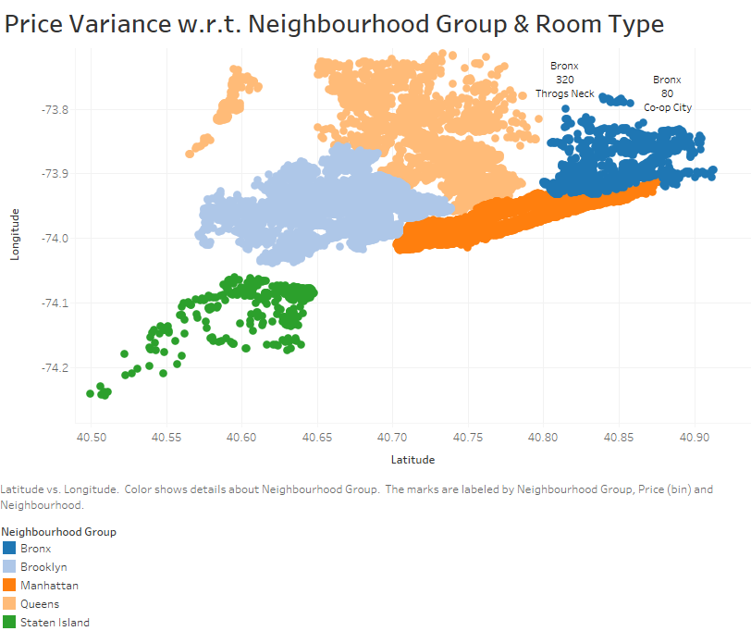
Graph shows how AirBNB properties are spread across New York.
Figure shows Dark orange patch in Manhattan which means maximum properties are spread in Manhattem compared to other localities.

Slide 7
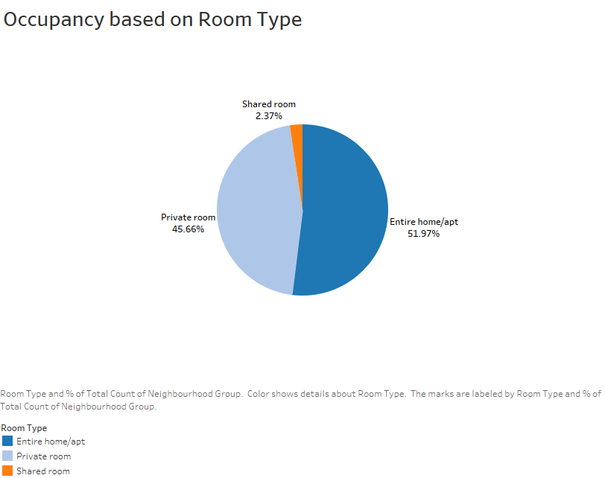
Graph shows different types of rooms namely private room, shared room, entire home/apt
52% of all booking are with Entire home/apt. And next most preferred type is private room which takes around 45% of all booking. Shared room are least opted with just 3% of total booking.

Slide 8
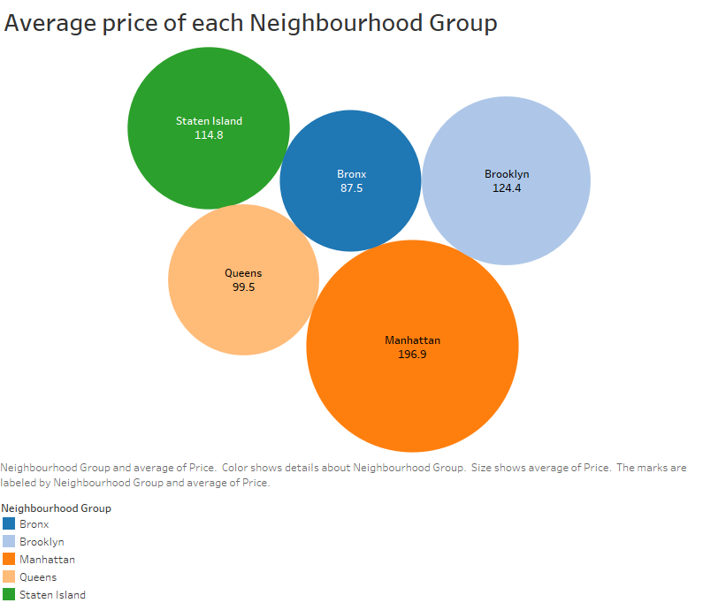
This figure shows the average booking price.
Manhattan which has highest number of booking also has highest average price. Followed by Brooklyn and Staten Island.
Queens and Bronx are cheaper compared to other places.

Slide 9
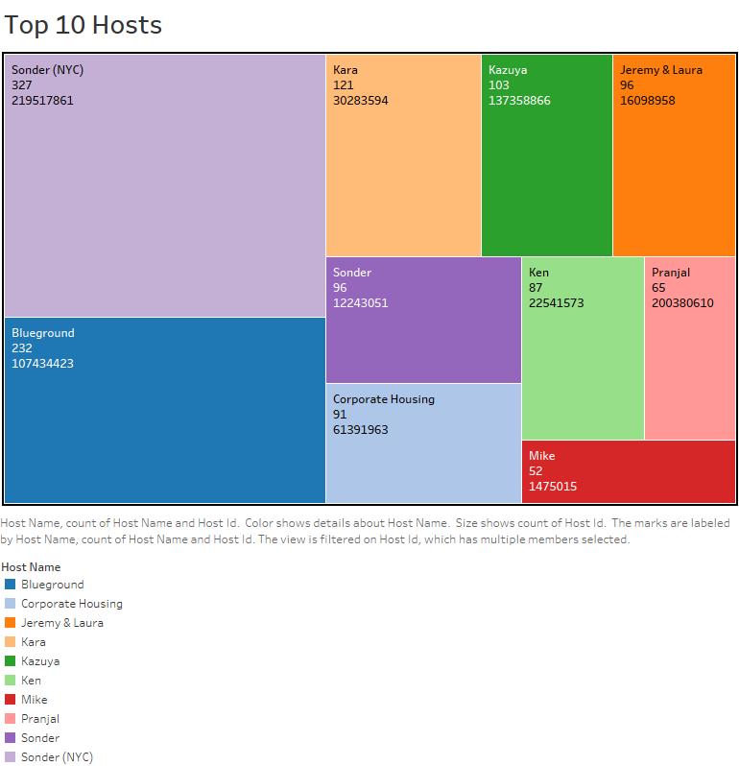
Figure shows Top 10 Hosts where booking is done most.
Sandor(NYC) has highest booking followed by Blueground.
Pranjal and Mike properties comes in 9th and 10th place respectively.
Count shows number of times bookings make in each hotel along with host ID.

Slide 10
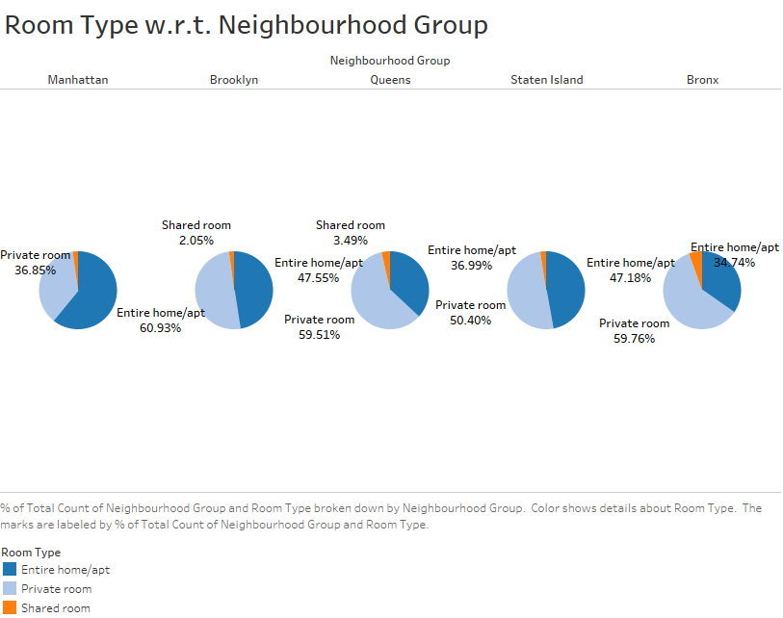
Figure shows how type of room bookings differ from place to place.
People booking in Manhatten prefer Entire Home/Apt
However People booking in Statan Island and Brooklyn prefer to go almost 50-50 with Private room and Entire Home/Apt.
People booking in Queens and Brons prefer to book Private room.

Slide 11
Thank you

